Slide 1


od zera…
…do bohatera

Slide 2
Agenda
Czym jest Python
kamień/papier/nożyczki
Trochę teorii: listy, słowniki, funkcje…
Zadanie praktyczne
Co dalej… ?

Slide 3
Wymagania
zainstalowany Python na komputerze:
najlepiej 3.7, 3.8, 3.9
przydane linki:
Python: https://www.python.org/
Wersje Python dla systemu Windows: https://www.python.org/downloads/windows/
Instrukcja jak zainstalować Python na systemie Windows: https://www.youtube.com/watch?v=9Xg0M1Lz020 (instrukcja do 7:54 - nie potrzebujemy Visual Studio)
Wersje Python dla systemu macOS: https://www.python.org/downloads/macos/
Instrukcja jak zainstalować Python na systemie macOS: https://www.youtube.com/watch?v=ezUCZiMXB20
zainstalowany PyCharm CE na komputerze:
Najlepiej wersja Community
Przydatne linki:
PyCharm CE https://www.jetbrains.com/pycharm/
Wersje dla systemu Windows: https://www.jetbrains.com/pycharm/download/#section=windows
Jak zainstalować PyCharm na systemie Windows: https://www.youtube.com/watch?v=z73PyNDgVyQ
Wersje dla systemu macOS: https://www.jetbrains.com/pycharm/download/#section=mac
Jak zainstalować PyCharm na systemie macOS: https://www.youtube.com/watch?v=K5cAu-Wro3M

Slide 4
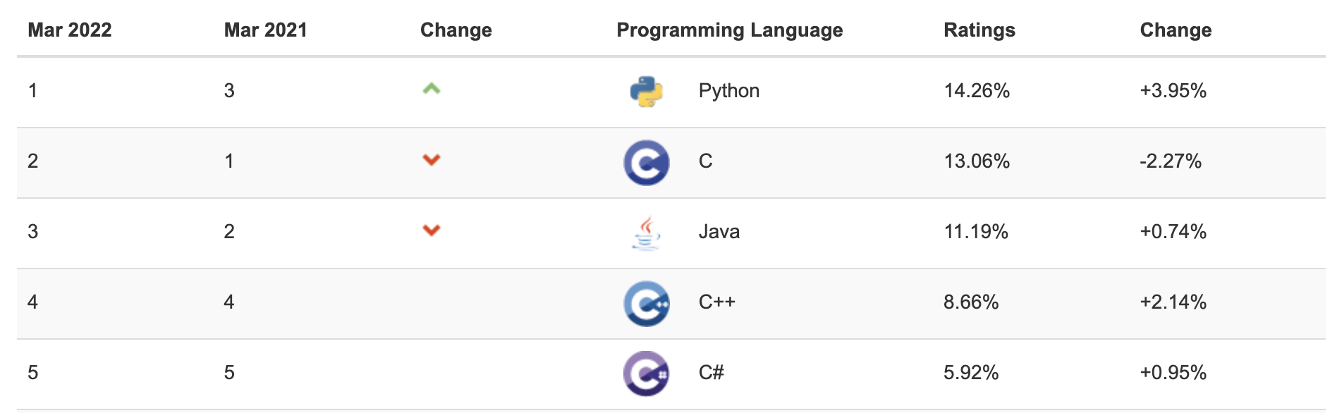
Czym jest Python… ?
Web Development
Data Science
Machine Learning
Automation
source: https://www.tiobe.com/tiobe-index/

Slide 5


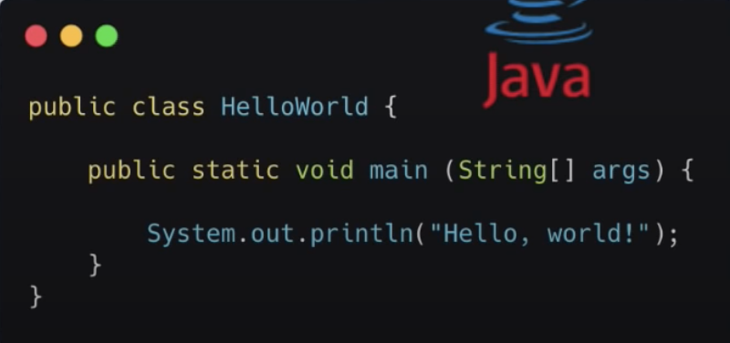
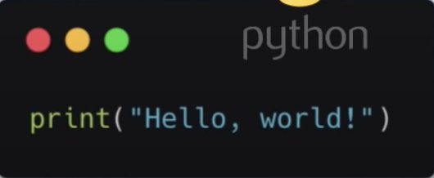
Dlaczego Python… ?
Prosta składnia (syntax)
Biblioteki
Prosta konfiguracja
Społeczność
Prosta konfiguracja

Slide 6

Co dalej
basic
intermediate
advanced
variables
conditions
operators
control flow
loops
functions
mutable vs. immutable
common methods
object orientated programming (oop)
data structures
comprehension
lambda functions
*arg & **kwargs
inheritance
advanced classes
pip
decorators
generators
context manager
metaclasses
concurrency & parallelism
testing
build packages
cython

Slide 7
Python Interview Questions!
What is the difference between %, /, and //?
What is the difference between del(), clear(), remove(), and pop()?
What is the difference between sort and sorted?
What is the difference between indexing and slicing?
What is the difference list and tuple?
Explain zip() and enumerate() function.
What is the lambda function?
What is the difference between pass, continue and break?
What is the use of the With statement?
What is if __name__ == “__main__”?
What is a docstring?
What is the difference between instance variable and class variable?
source: https://www.analytixlabs.co.in/blog/python-interview-questions-for-data-science/

Slide 8
Machine Learning
past: make your data tell the story…
now: make your data bring money…

Slide 9
Agenda
DS. vs. MLE vs. MLOps
ML Project Life Cycle
Introduction to NumPy & Pandas
Classification

Slide 10






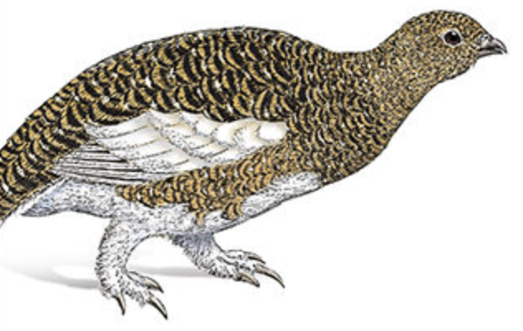




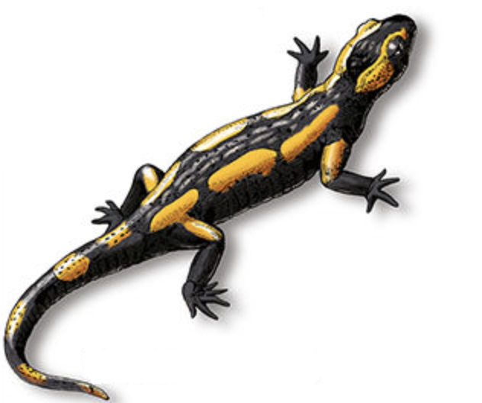
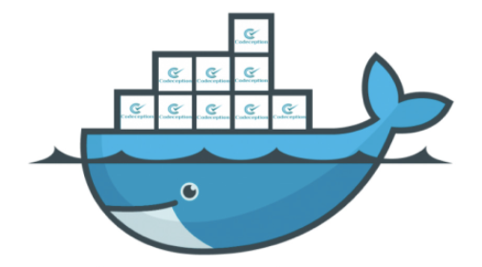


DS vs. MLE vs. MLOps

Slide 11
ML Project Life Cycle
Business Understanding
Data Understanding
Data Preparation
Deployment
Modeling
Evaluation
CRISP-DM

Slide 12
tools example:
SQL
Python:
Jupyter (IDE)
pandas
NumPy
Business Understanding
Data Understanding
Data Preparation
SQL
Python:
Jupyter (IDE)
pandas
NumPy
Deployment
Python:
PyCharm (IDE)
OOP
software development
flask/FastAPI
Makefile
GCP/AWS (cloud)
Modeling
Python:
Jupyter (IDE)
scikit-learn
TensorFlow/Pytorch
Evaluation
Python:
matplotlib/plotly
dash (dashboard)
Tableau/PowerBI
CRISP-DM

Slide 13
DS
tools example
SQL
Python:
Jupyter (IDE)
pandas
NumPy
Business Understanding
Data Understanding
MLE
Data Preparation
SQL
Python:
Jupyter (IDE)
pandas
NumPy
Deployment
Python:
PyCharm (IDE)
OOP
software development
flask/FastAPI
Makefile
GCP/AWS (cloud)
Modeling
Python:
Jupyter (IDE)
scikit-learn
TensorFlow/Pytorch
Evaluation
Python:
matplotlib/plotly
dash (dashboard)
Tableau/PowerBI
CRISP-DM

Slide 14
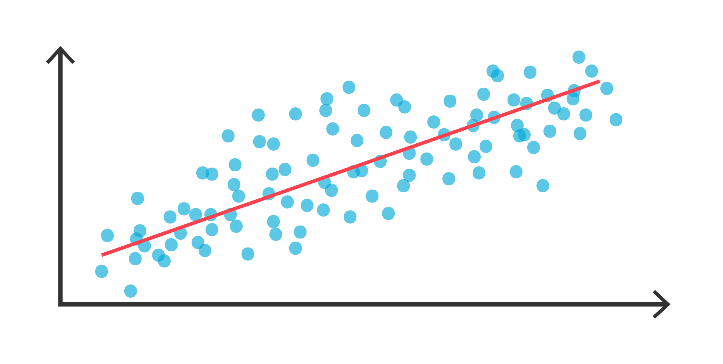
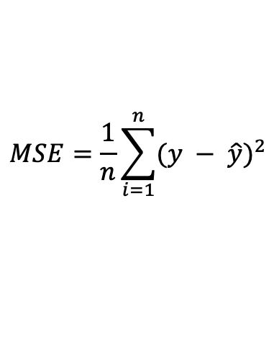
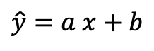
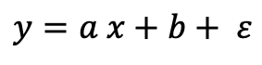
Regression
$$y=a x+b+ ε$$
$$MSE=\frac{1}{n}\sum_{i=1}^{n}{{(y − \hat{y})}^{2}}$$
$$\hat{y}=a x+b$$

Slide 15



Train Test Split
Train Set
target variable
labels
Test Set
model predict True

Slide 16
Classification
target variable
MODEL

Slide 17
Classification
target variable
MODEL
ACTUALS
PREDICTIONS

Slide 18
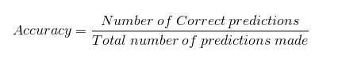
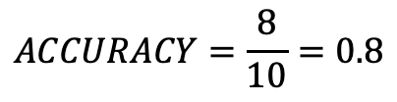
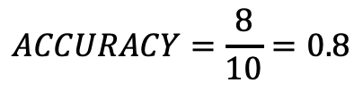
Metrices: Accuracy
$$ACCURACY=\frac{8}{10}=0.8$$
ACTUALS
PREDICTIONS

Slide 19
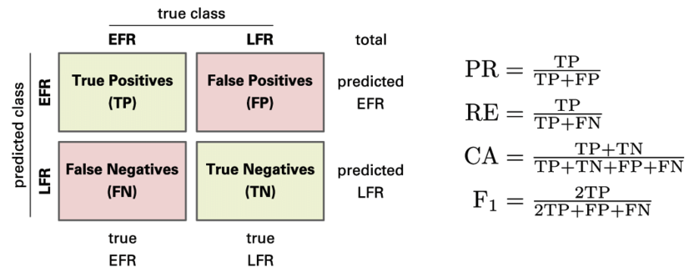
Metrices: Confusion Matrix
https://en.wikipedia.org/wiki/Confusion_matrix
TP = 4
FP = 1
FN = 1
TN = 4
ACTUALS
PREDICTIONS

Slide 20
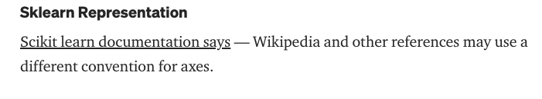
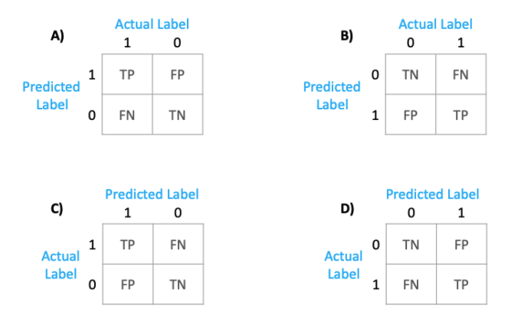
Confusion Matrix from scikit-learn
https://towardsdatascience.com/understanding-the-confusion-matrix-from-scikit-learn-c51d88929c79

Slide 21

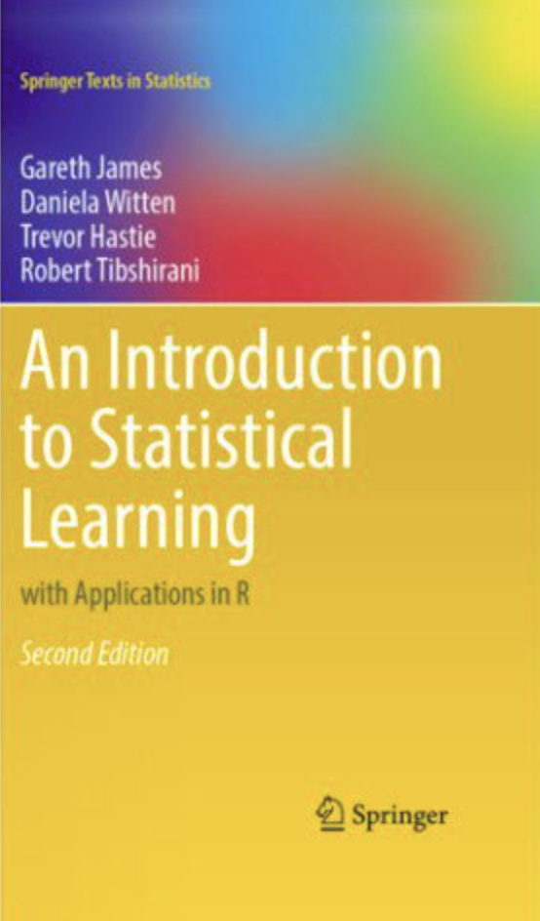
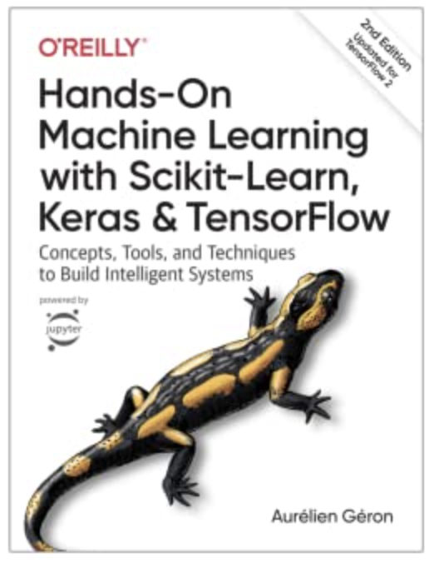
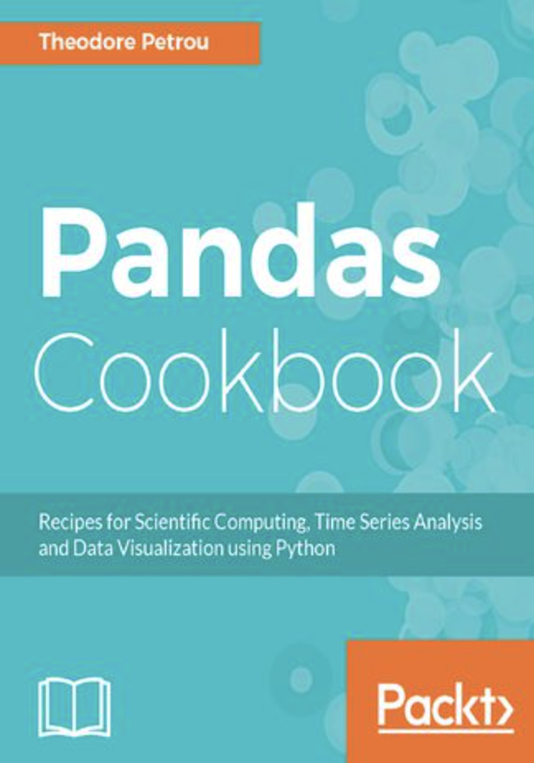
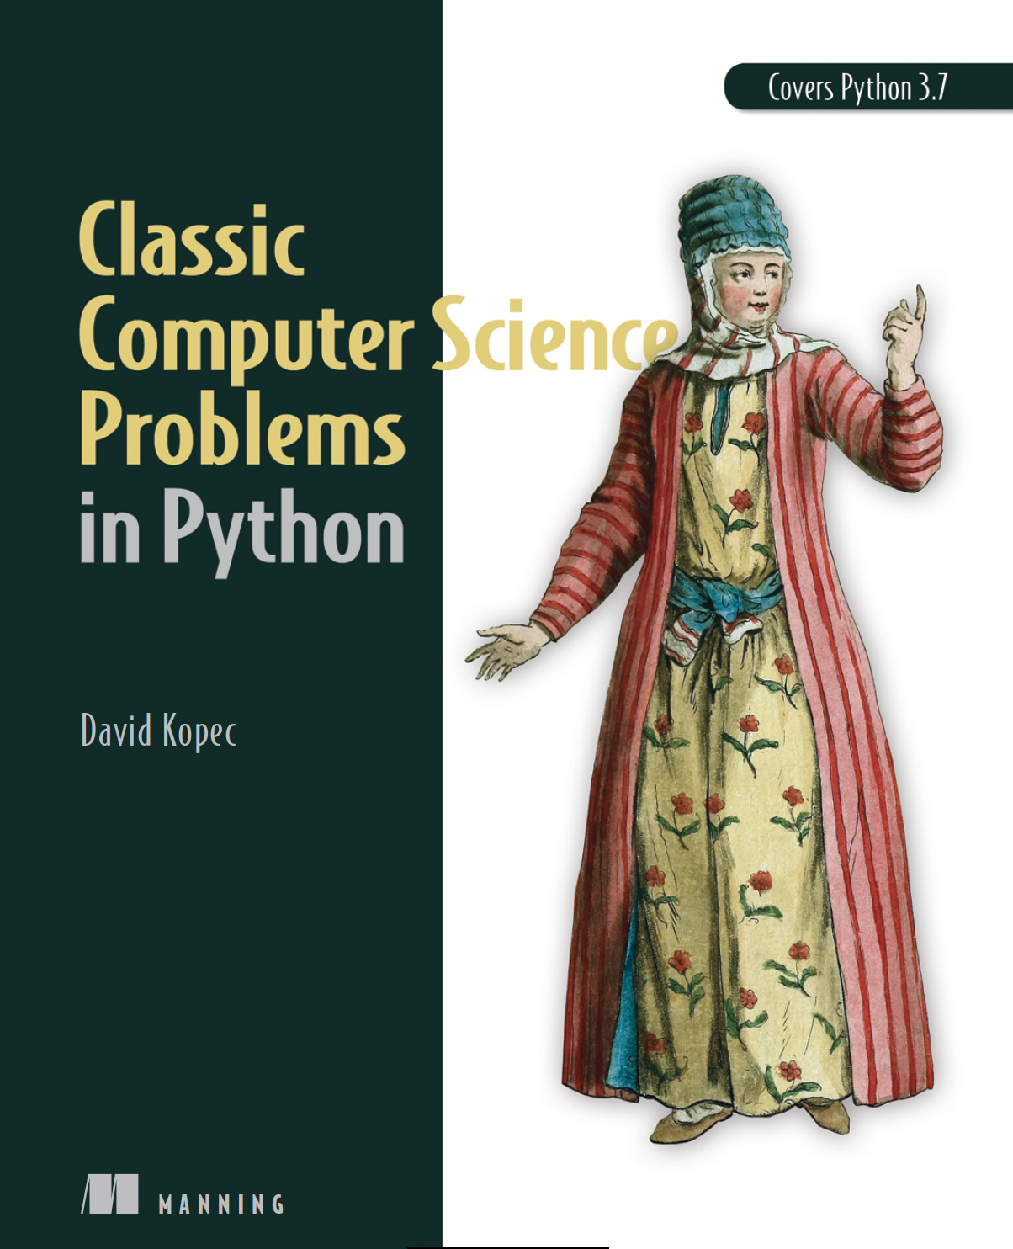

Knowledge resources
StatQuest: https://www.youtube.com/c/joshstarmer
Tech with Tim: https://www.youtube.com/c/TechWithTim
Tech word with Nana: https://www.youtube.com/c/TechWorldwithNana
Machine Learning Study Groups: https://www.youtube.com/channel/UCMEQFEKrsRFBXnUIreTACxg
Towards Data Science: https://towardsdatascience.com/
Machine Learning Mastery: https://machinelearningmastery.com/
Kaggel: https://www.kaggle.com/

Slide 22




Interesting technologies

Slide 23
THANK YOU

Slide 24
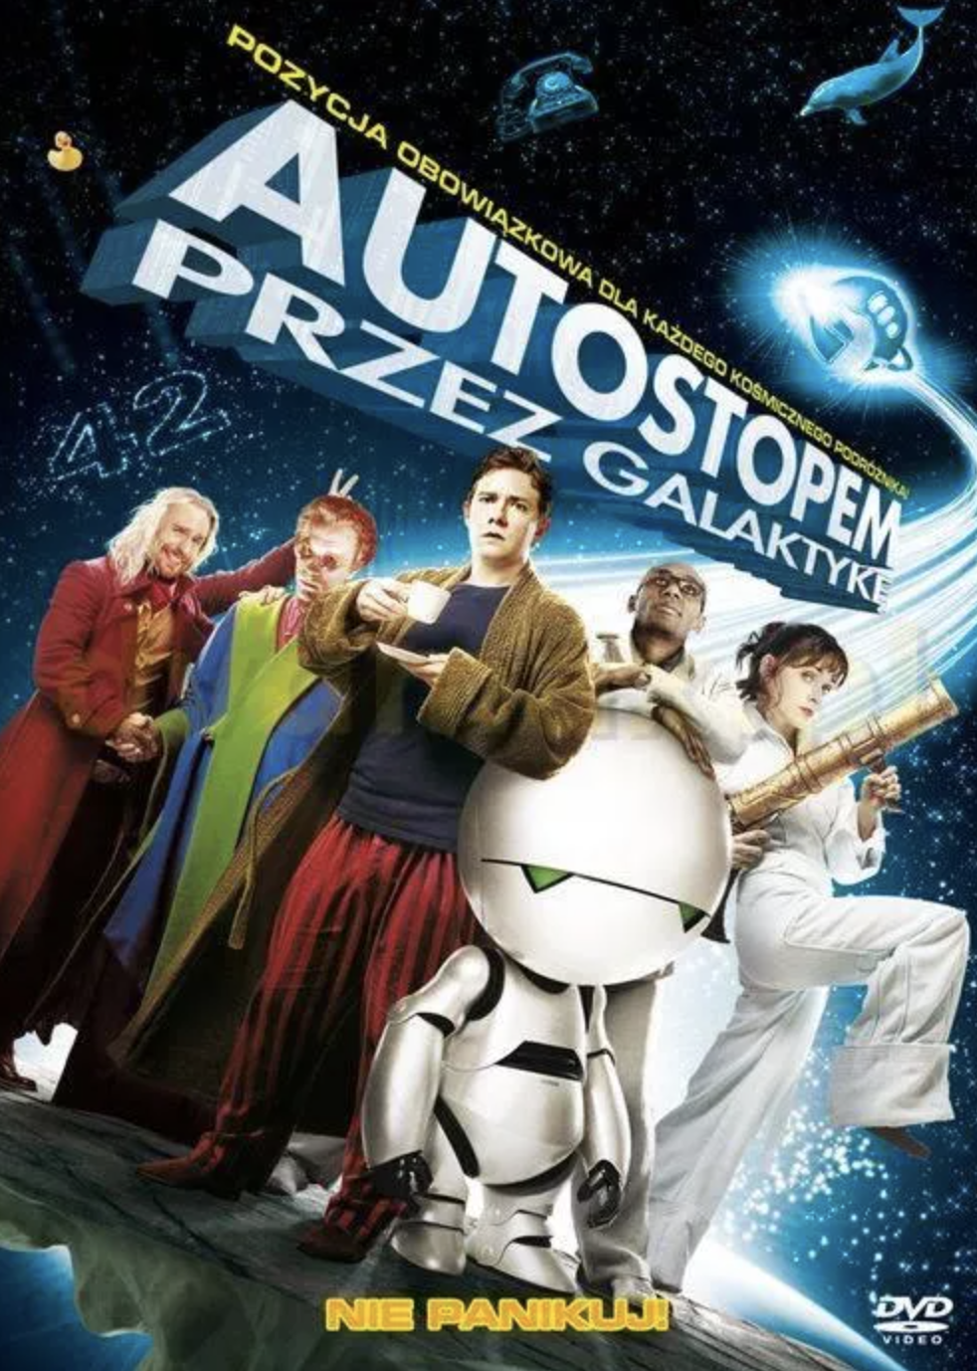
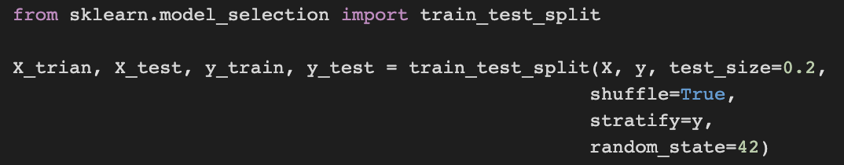
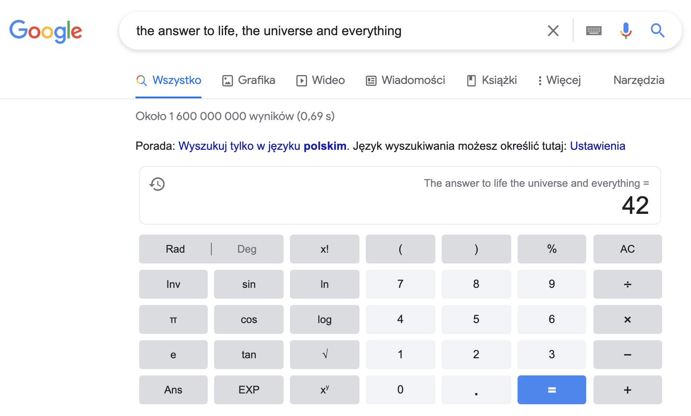
Easter Egg: Why 42…?
Wielkie pytanie o życie, wszechświat i całą resztę.
https://www.youtube.com/watch?v=aboZctrHfK8
https://www.google.com/search?hl=pl&q=the+answer+to+life%2C+the+universe+and+everything
https://pl.wikipedia.org/wiki/Wielkie_pytanie_o_%C5%BCycie,_wszech%C5%9Bwiat_i_ca%C5%82%C4%85_reszt%C4%99

